Slide 1
Information
Information:
Information is defined as a sequence of letters,
alphabets, symbols which specific meaning.
Source of Information:
carries a message with
The sources of information can be divided into 2 types.
Analog Information sources
Digital information sources
Analog information sources produce continuous amplitude continuous time electrical waveforms.
Discrete information sources produces messages consisting of discrete letters or symbols.

Slide 2
Information content of a message
The information content of a message is represented by the probability or uncertainty of the event associated with the message.
The probability of occurrence of a message is inversely related to amount of information.
Therefore, a message with least probability of occurrence will have maximum amount of information.

Slide 3
Information content of a message
The relation between information content of message and its probability of occurrence is given by,
I_{k} = log (1/P_{k})
The unit of information is bit.
I_{k} = log ₂(1/P_{k}) bits,
I_{k} = log₁₀ (1/P_{k})Decits,
I_{k} = log_{e}(1/P_{k}) nats.

Slide 4

Entropy (Average information content)
Entropy is defined as information conveyed denoted by H.
the average by a
amount of
is
message. It
Properties of Entropy:
Entropy is always non negative i.e H(x) ≥ 0.
Entropy is zero when probability of all symbols is zero except probability one symbol is one.
Entropy is maximum when probability occurrence of all symbols is equal
i.e H(x) =

Slide 5
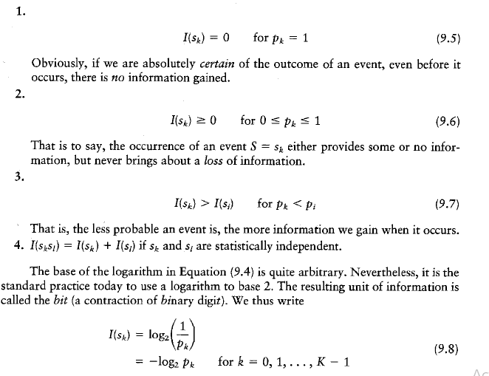

Slide 6
Source Coding Theorem
Source Encoding is the process for efficient representation of data generated by the discrete source.
The device that performs this representation is called Source Encoder.
Eg. is Morse code.
An efficient source encoder satisfies the following two requirements.
The source code produce by the encoder are in binary form.
The source code is uniquely decodable.

Slide 7
Source Coding Theorem
The average code word length of the source encoder is
= represents average number of bits per symbol source.
The coding efficiency of the source encoder is

Slide 8
Data Compaction
For efficient signal transmission the redundant information are removed with no loss of information – Data Compaction or Lossless data transmission.
Prefix Coding
For a source code representing the output of the source the code has to be uniquely decodable.
A special code known as prefix code satisfying a restriction known as the prefix condition is used.
A prefix code is a code in which no code word is the prefix of any other code word.

Slide 9
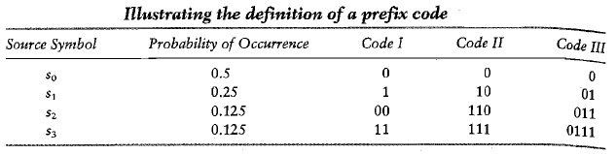
Prefix Code
Code I and III is not a prefix code but Code II is.

Slide 10
Prefix Code
Decision Tree for the above table. The encoded sequence 10 111 110 0 0 is decoded as the source sequence s₁s₃s₂s_{o}s_{o.}
A prefix code has the important property that it is uniquely decodable.

Slide 11
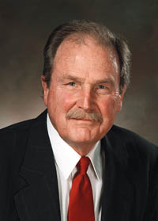
Huffman Coding
A procedure to construct optimal prefix-free code
Result of David Huffman’s term paper in 1952 when he was a PhD student at MIT
Shannon → Fano → Huffman
Observations:
Frequent symbols have short codes.
In an optimum prefix-free code, the two code words that occur least frequently will have the same length.

Slide 12
Huffman Coding
Is to assign to each symbol of an alphabet a sequence of bits roughly equal in length to the amount of information conveyed by the symbol in question.
The average code word length approaches the fundamental limit set by the entropy.
The Huffman code replaces the prescribed set of source statistcs with a simpler one.

Slide 13
Huffman Encoding Algorithm
The source symbols listed in the order of decreasing probability. The two source symbols of lowest probability is assigned a 0 or 1. ---- Splitting Stage.
These two source symbols are combined into new source symbol of probability equal to the sum of the two original probabilities.
The probability of new symbol placed in the list in accordance with its value.
The procedure is repeated until we are left with a final list of source statistics of only two for which 0 and 1 are assigned.

Slide 14
Huffman Encoding Algorithm
Human Coding - a bottom-up approach
Initialization: Put all symbols on a list sorted according to their frequency counts.
This might not be available !
Repeat until the list has only one symbol left:
(1) From the list pick two symbols with the lowest frequency counts. Form a Huffman sub tree that has these two symbols as child nodes and create a parent node.
(2) Assign the sum of the children's frequency counts to the parent and insert it into the list such that the order is maintained.
(3) Delete the children from the list.
Assign a codeword for each leaf based on the path from the root.

Slide 15
Huffman Tree
The five symbols of the alphabet of a discrete memoryless source and their probabilities are given.

Slide 16
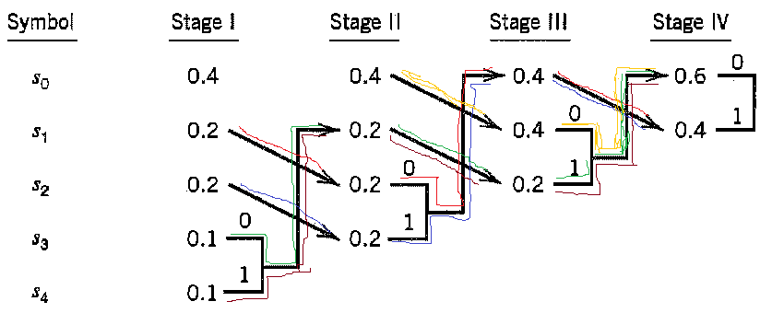
Huffman Tree

Slide 17
Huffman Tree
The average code word length is

Slide 18
Huffman Tree
The entropy of discrete memoryless source is
The efficiency of the source encoder is
= 2.12193/2.2 = 96.45%

Slide 19
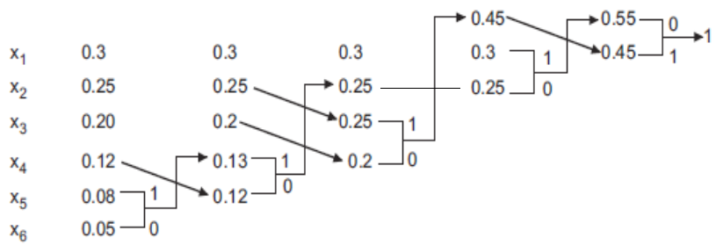
Example 2
1
0

Slide 20
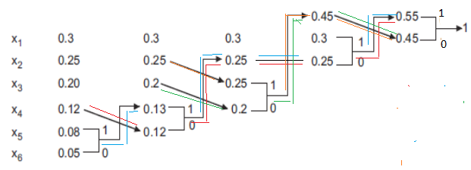
Example 2

Slide 21
Example 2
Symbol | Probability | Code word
X₁ | 0.3 | 11
X₂ | 0.25 | 01
X₃ | 0.20 | 00
X₄ | 0.12 | 100
X₅ | 0.08 | 1011
X₆ | 0.05 | 1010

Slide 22
Example 2

Slide 23
Example 2
= 2 × 0.3 + 2 × 0.25 + 2 × 0.20 + 3 × 0.12 + 4 × 0.08 + 4 × 0.05
= 2.38
= 2.35 / 2.38 = 98.73%

Slide 24

Example 2
The variance of the average code word length over the ensemble of source symbol is
= 0.3(2-2.38)² + 0.25(2-2.38)² + 0.2(2-2.38)² + 0.12(3-2.38)²
+ 0.08(4-2.38)² + 0.05(4-2.38)²
= 0.3 × 0.1444 + 0.25 × 0.1444 + 0.2 × 0.1444 + 0.12 × 0.3844 + 0.08 × 2.6244 + 0.05 × 2.6244
= 0.58548

Slide 25
THANK YOU !!

